Slide 1

Market Segmentation
Fabiola Manjoh and Aleksander Boski

Slide 2
GOAL:
Create a marketing campaign for each customer segment

Slide 3
Structure
Dataset description
Data pre-processing and cleaning
Feature engineering
Feature selection
PCA or not PCA
K-means: choosing k
Clusters
Cluster analysis
Business recommendations

Slide 4

Engineered features
Children
Total purchases
Conversion rate
Days as customer
Frequency of purchase
Relative spending
Price sensitivity

Slide 5
CLUSTER ANALYSIS!

Slide 6
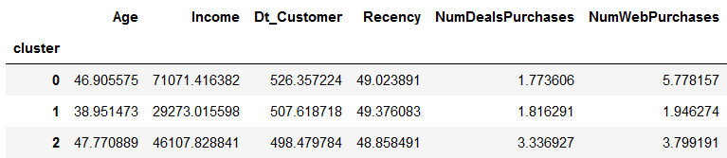

Slide 7
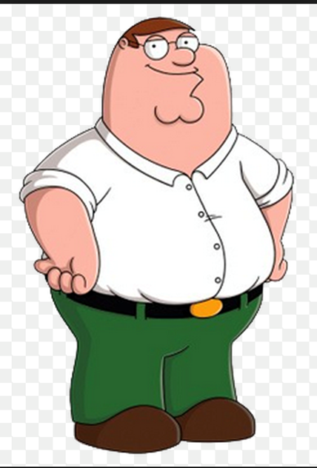
Cluster 1 – Rich meat lover
Peter makes 70k a year, he’s in the top tier income-wise!
He has the most purchases
Oldest client
No children, most likely to be single
High meat consumption
High conversion rate – internet savvy!
Low price sensitivity

Slide 8

Cluster 2 – Working class Loves gold
Alexis is the youngest client
She makes 30k a year, putting her in the bottom tier income-wise!
Least educated
Avid gold-product buyer
She has the least purchases
Low conversion rate
High price sensitivity

Slide 9

Cluster 3 – Middle class, loves wine, has kids
Apu makes 42k/year
Most recent client
Married, 2 kids
High wine consumption
Highest price sensitivity

Slide 10
Recommended approach for Cluster 1

Slide 11
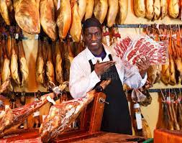

Fabiola is waiting for you on meaty-Tuesday!! Come taste the highest quality meats from Cameroon!!

Slide 12
Recommended approach for Cluster 2

Slide 13
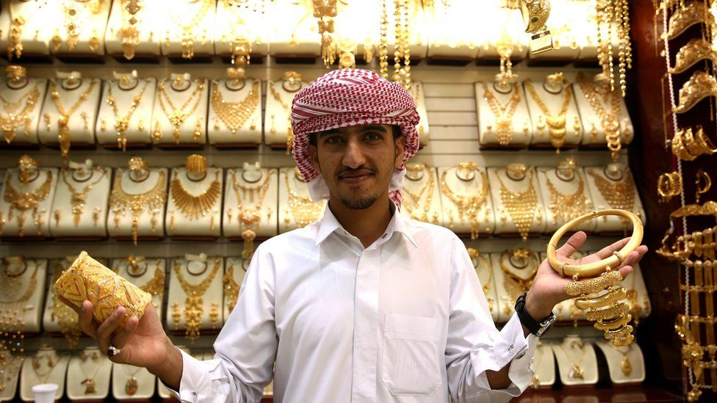

We are happy to introduce Nelson’s bling-bling-Saturday!! Get 10% off on every gold product!!

Slide 14
Recommended approach for Cluster 3

Slide 15

Are your kids grinding your gears?

Slide 16

Need a way to relax, forget about your worries?

Slide 17
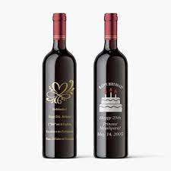
We’re introducing: Self-care Friday! 1 bottle of wine bought = pay 50% less on the second one!!

Slide 18
THANK YOU!

